Slide 1

OpenAI Tax Advisor
Open AI, Azure Speech Service, Neo4j GraphDB

Slide 2
One of the biggest benefits of AI is being able to interface with computer and backend services using natural language. This gives end users who don’t know anything about querying databases the ability to get information needed for their job. This is how we came up with the idea to use NLP to take what the person is saying, transform it into a query for the neo4j graphdb database. This also grounds the answers of the openAI instance to eliminate hallucinations.
Description:

Slide 3
Situation: Taxes, Information on litigation, and medical can be abundant on the internet but of not tailored to individual situations. AI can help this problem by personalized the results but suffers from unreliability and hallucinations. For example: Helping people with DIY tax help like if they would with a tax advisor
Task: Use AI to translate user intent and generate answers. Use speech recognitions to mimic normal conversations. Ground the AI to a knowledge database to eliminate hallucinations. Use AI to help in the creation of the knowledge database using tags
Action: Use Open Azure Speech Service to service conversation with users. Ground OpenAI to a neo4j graphdb knowledge database. Generate the database using the help of LLM to process the data using tags and relationship.
Result: Open AI chat bot Tax Advisor that answers questions correctly

Slide 4
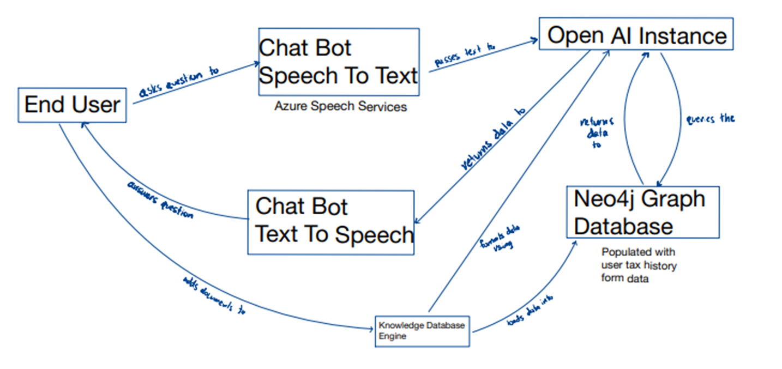

Slide 5
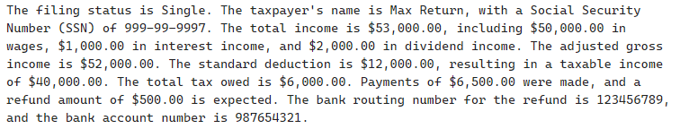
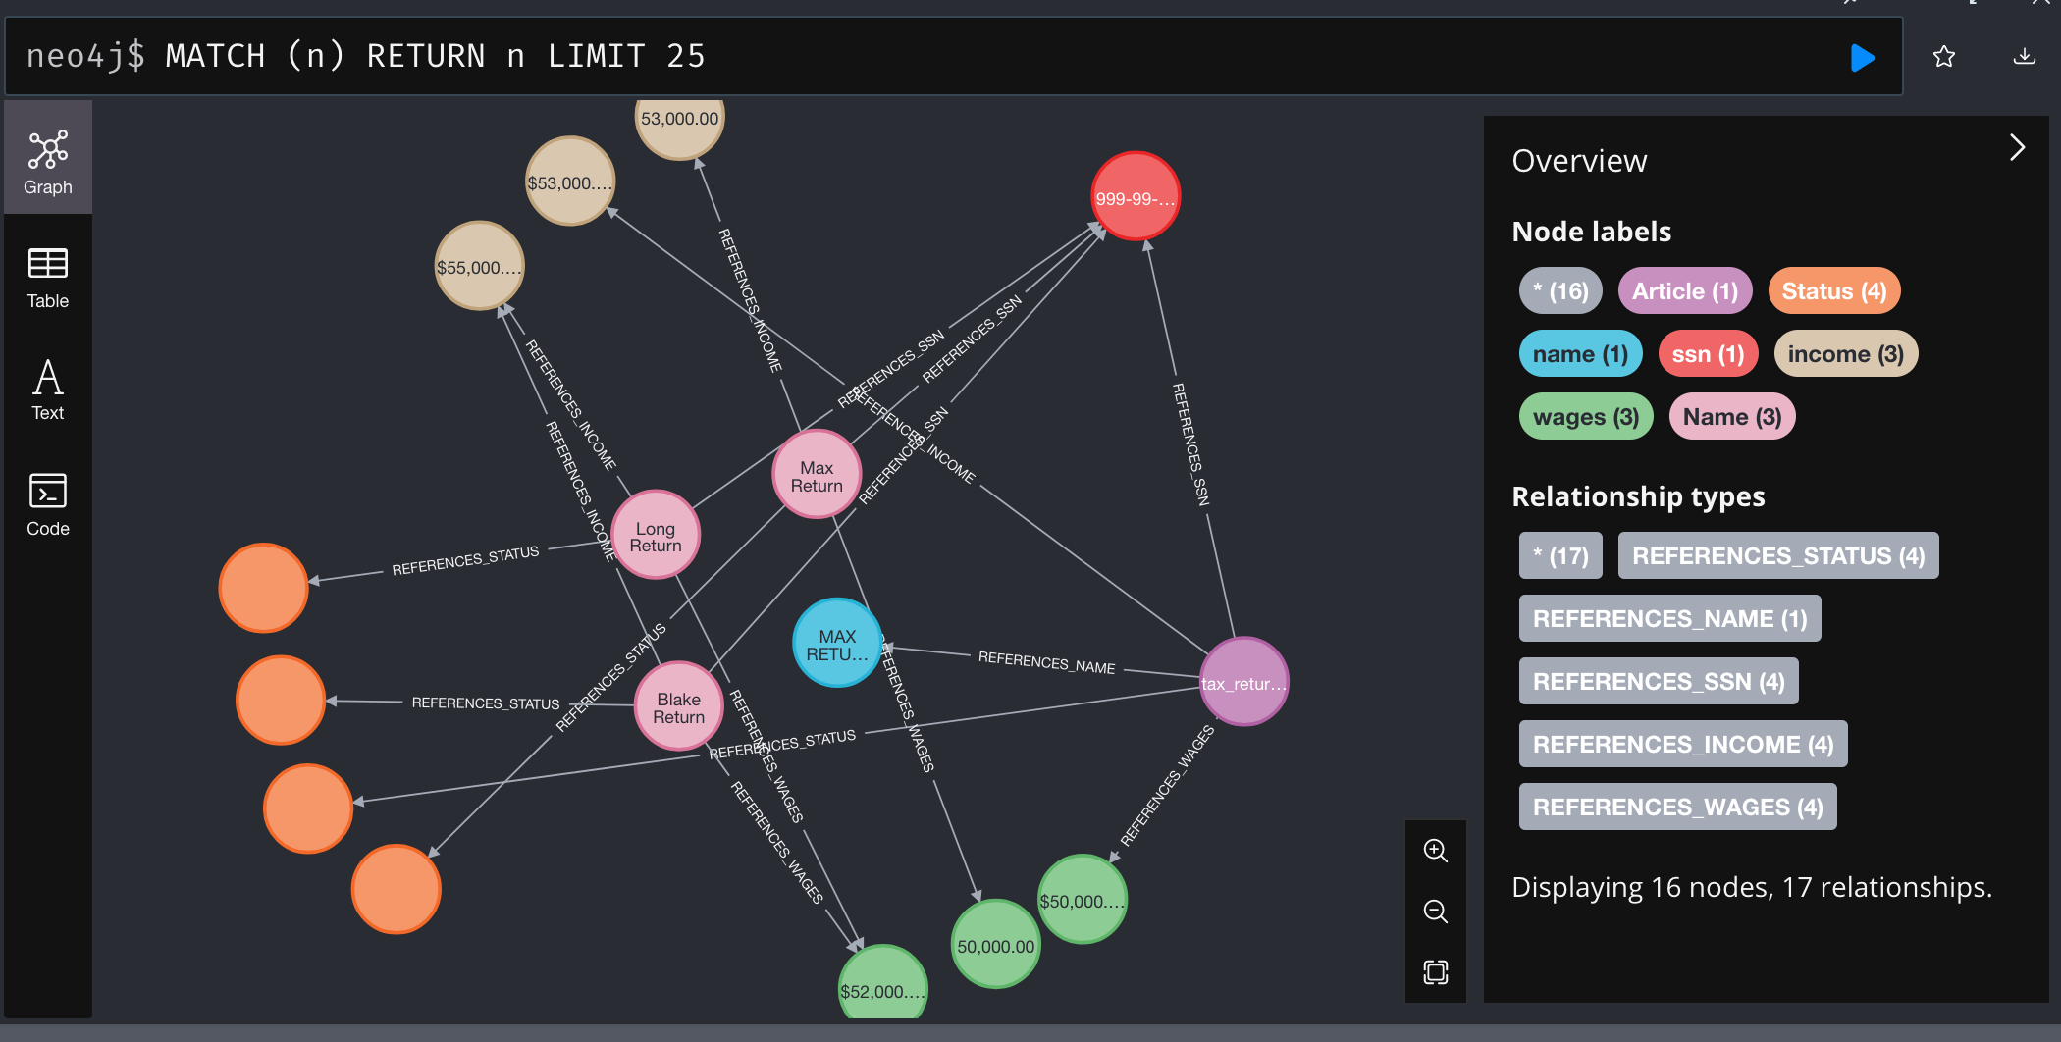
Raw Knowledge database

Slide 6
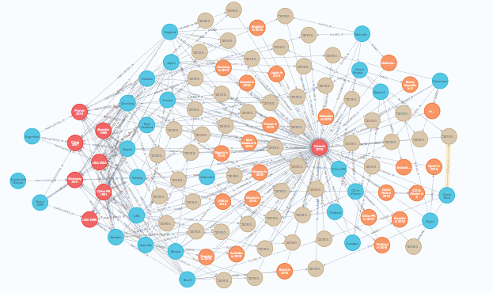
Example of a processed database

Slide 7
DEMO
Chatbot

